Slide 1
Learning- Team3
TEAM MEMBERS
Gaurav Khetwal
Davinder Singh
Umang Murawat
Jivan Goyal
Navjot Singh
Researchers - Valeria Insigna
Zuma Zevick
George Osang

Slide 2
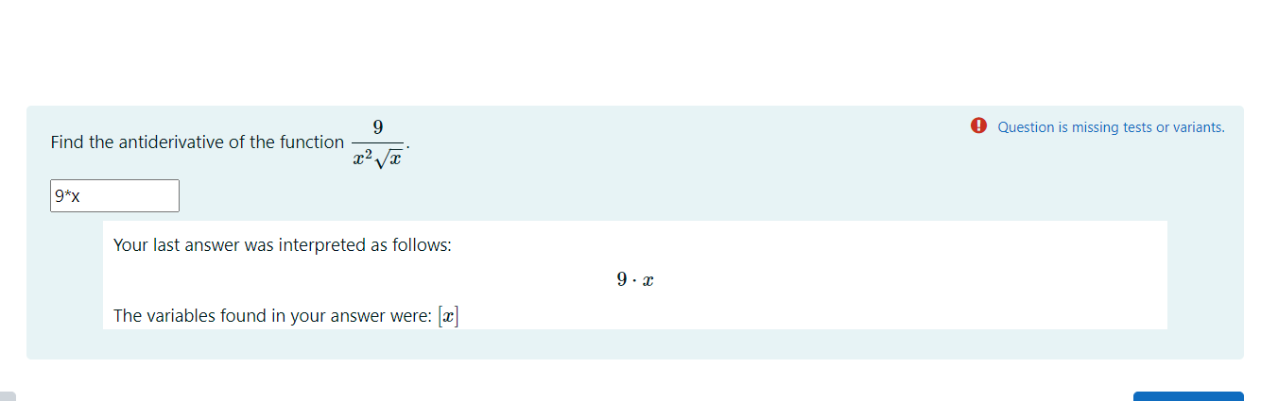
Problem
While answering tests students are making mistakes which was not anticipated. Now as the mistakes are random and different.

Slide 3
Solution Steps
Data cleanup and removing unnecessary data
Considering each test result as unique
Direct Insights from the existing data
Create Vocabulary and Contingency table
Correspondence Analysis
Apply K-means method for clustering
Adding Cluster results to the original data and draw insight

Slide 4
Direct Analysis

Slide 5
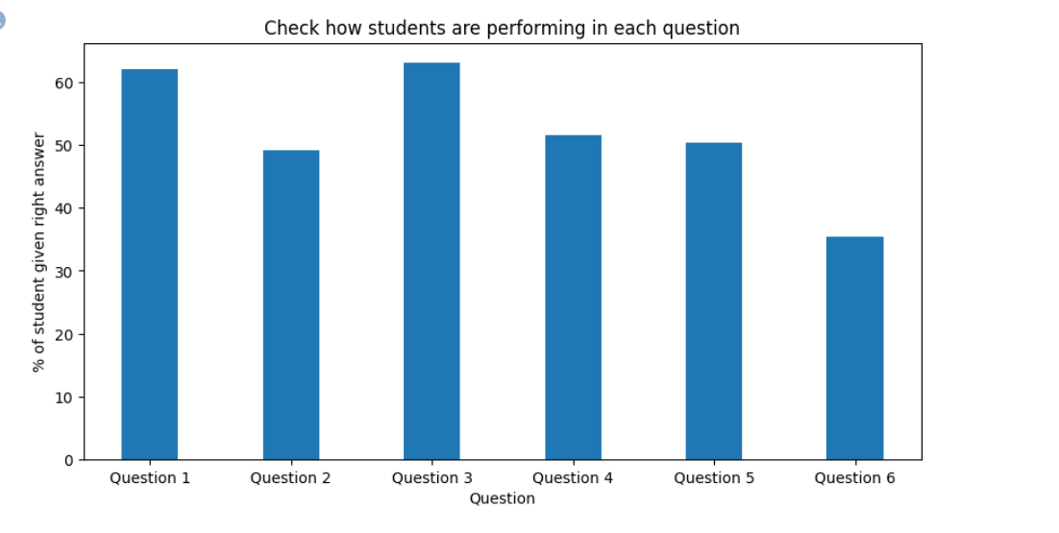

Slide 6
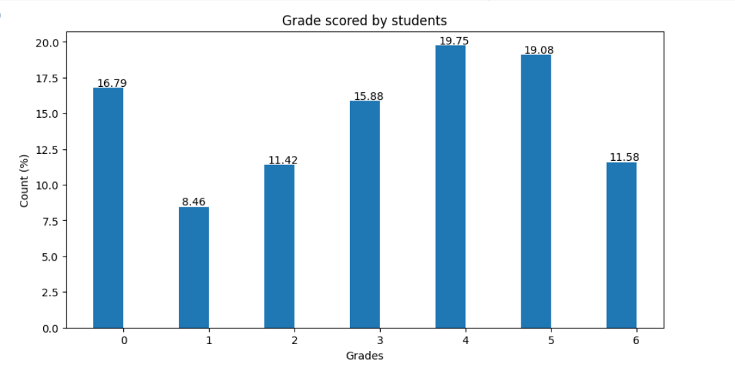

Slide 7
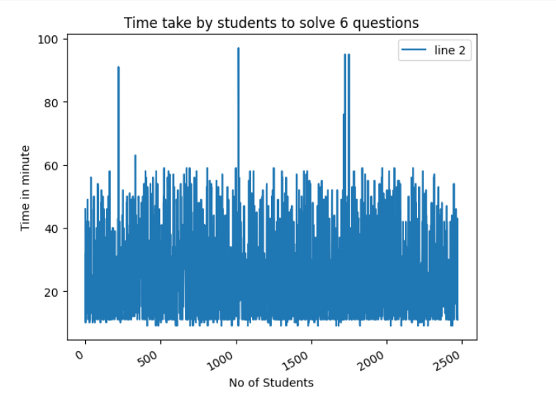

Slide 8
Improvements
Increase in no. of n_components for Correspondence Analysis.
Add mathematical functions and symbol to the vocabulary for creating contingency table.
Effective no. of clusters based on the better data view.
Create api to fetch this clustering data and work as an input to the system

Slide 9
File Paths
Cleaning and Insights:
https://colab.research.google.com/drive/1h6lB-0beCysugl0meYzJXBWo23tng8Un#scrollTo=jisu5B7pwtvj
Modelling and Cluster data:
https://colab.research.google.com/drive/1AVnWsHjsHW2eVEgV1QkVA56dSbRL75Fk#scrollTo=zcFqzu6n4o-W

